Slide 1
RESUME CLASSIFICATION
PROJECT P(207)
TEAM MEMBERS:
Mr. Rohit Raju Kamble
Mr. Shivaprasad P Goni
Ms. Shama Patil
Ms. Shreya Guggare
Mr. Prayag V K
Ms. Kirthi Y Kudlappanavar
Mr. Swaroop
Mentors Name : Mr. Karthik Muskula
Ms. Dhanyapriya Somasundaram

Slide 2
Problem Statement :
Today the major problem being faced across the industry is how to acquire the right talent, using minimal resources over the internet and in minimal time. As described there are three major challenges that are required to be overcome, to bring efficiencies to the complete process.
• Separating the right candidates from the pack
• Making sense of candidate CVs
• Knowing that candidates can do the job before you hire them.

Slide 3
Business Objective
The document classification solution should significantly reduce the manual human effort in the HRM
It should achieve a higher level of accuracy and automation with minimal human intervention.
To make case of selection resumes for recruiter without actually going through each of them.
To help candidates to find and apply the most suitable job roles form the job.

Slide 4
PROJECT ARCHITECTURE :
COLLECTION OF DATA
BUSINESS UNDERSTANDING
EXPLORATORY DATA ANALYSIS(EDA)
DEPLOYMENT
FINALIZING MODEL
MODEL SELECTION

Slide 5
Importing Libraries :
We have to first install libraries to work on the resume classification dataset.
#!pip install python-doc
#!python -m pip install docx2txt
#!pip install textract
#!pip install python-docx
#!pip install xgboost
#!python.exe -m pip install --upgrade pip
#!pip install docs
#!python -m spacy download en_core_web_trf
#!pip install spacy-transformers

Slide 6
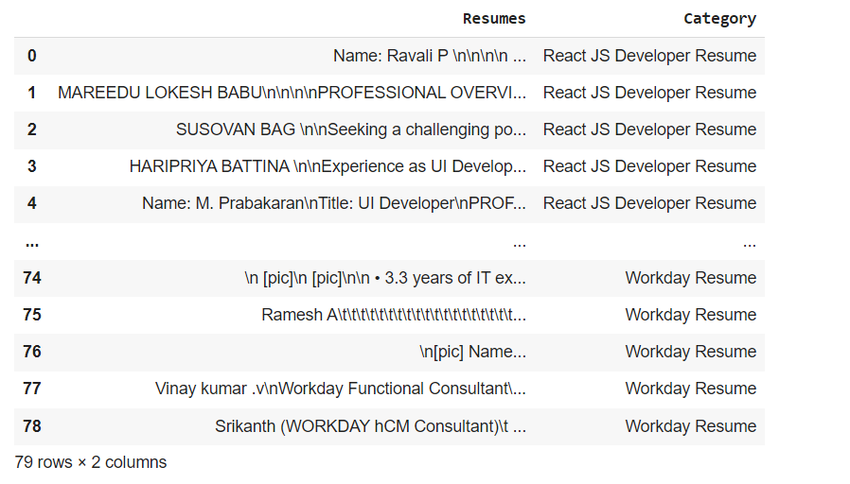
DataSet Details :
After Extracting and Modifying the Dataset, given data contains a total of 4 Classes, 2 features and 79 rows.

Slide 7
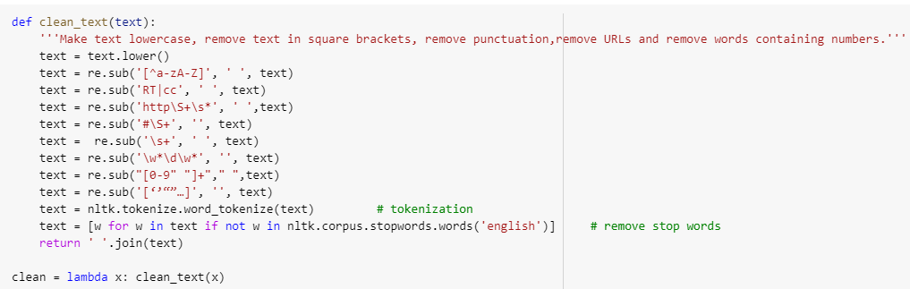
DATA UNDERSTANDING and EDA :
Removing all Unwanted Characters- \n \t, http links, tags, hashtags, html tags, converting to lower case, removing white spaces etc.
Word Tokenization - Tokenization is essentially splitting a phrase, sentence, paragraph, or an entire text document into smaller units, such as individual words or terms. Each of these smaller units are called tokens.
Removing Stop-words - A stop word is a commonly used word (such as “the”, “a”, “an”, “in”) that a search engine has been programmed to ignore, both when indexing entries for searching and when retrieving them as the result of a search query.

Slide 8
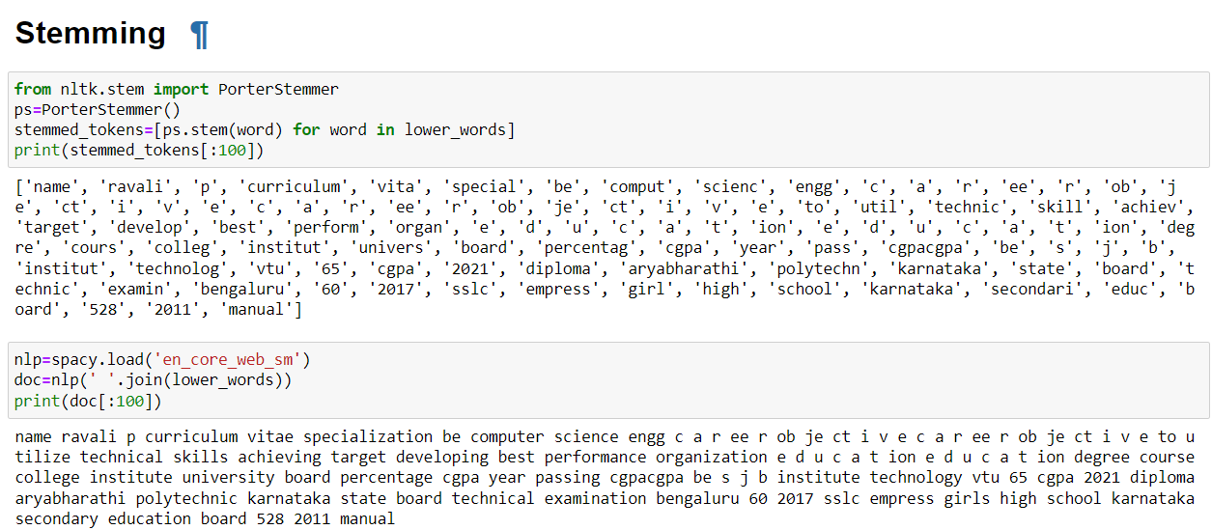
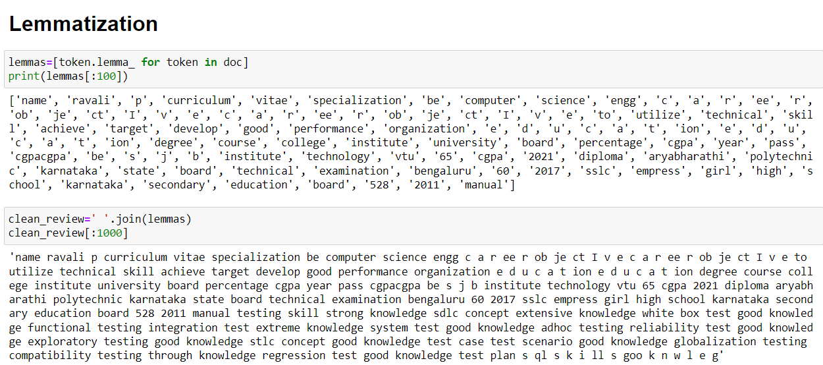
Text – Preprocessing :
The Porter stemming algorithm (or 'Porter stemmer') is a process for removing the commoner morphological and inflectional endings from words in English.

Slide 9
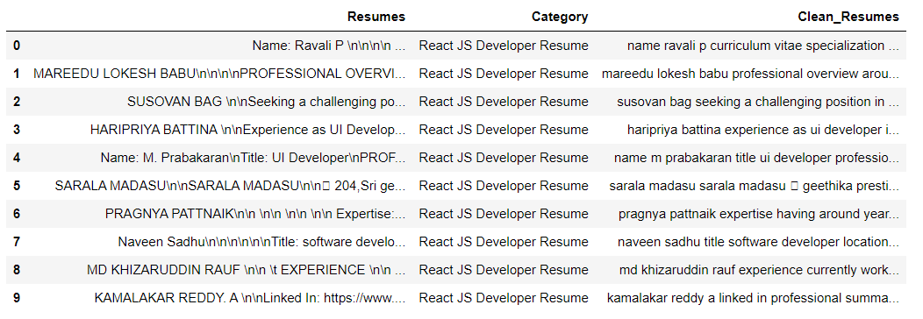
Text – Preprocessing :
In natural language processing, text preprocessing is the practice of cleaning and preparing text data. NLTK and re are common Python libraries used to handle many text preprocessing tasks.
Before Text – Preprocessing After Text – Preprocessing
The Dataset contains 79 rows and 3 Column
There are total four Classes – Peoplesoft, Workday, React JS Developer and SQL Developer.

Slide 10
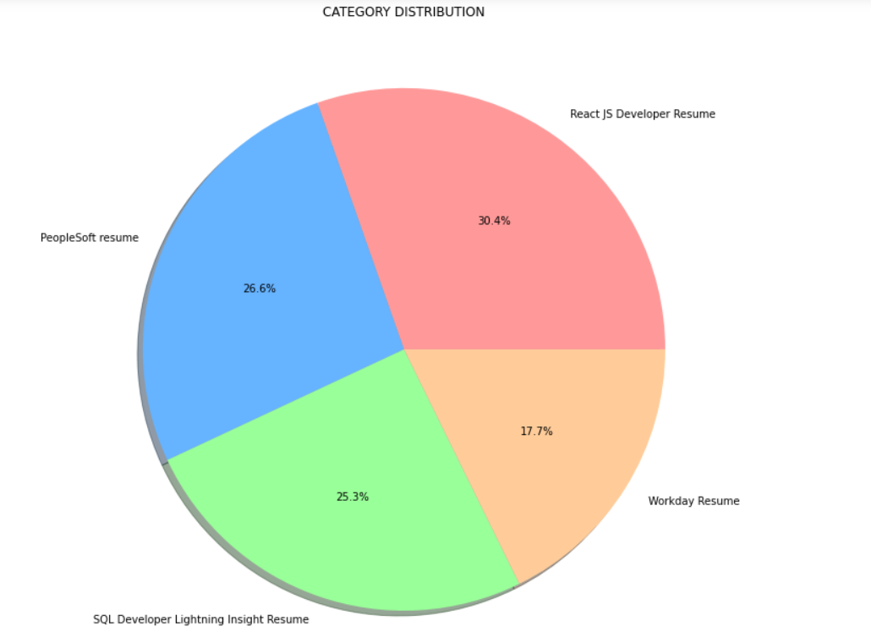
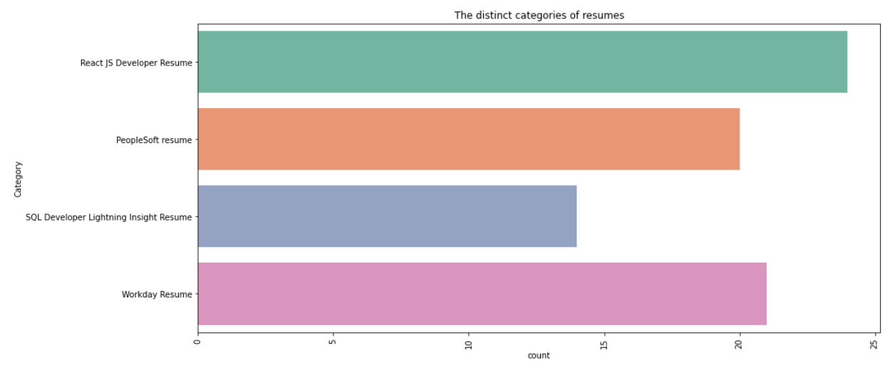
Visualization OF DATASET :
By using Pie chart role applied feature is displayed to visualize the job roles.
By using Histogram role applied feature is displayed to check the job types.

Slide 11
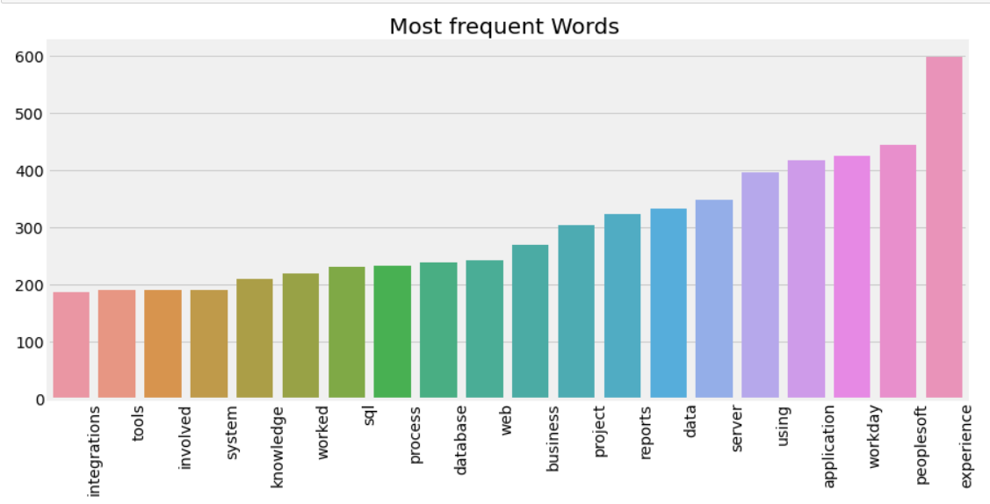
Word Frequencies in Resumes :
In this graph the frequency of Words in Resumes are show, there is most of the words are highly used in the dataset like Workday, Experience, experience, peoplesoft .etc

Slide 12
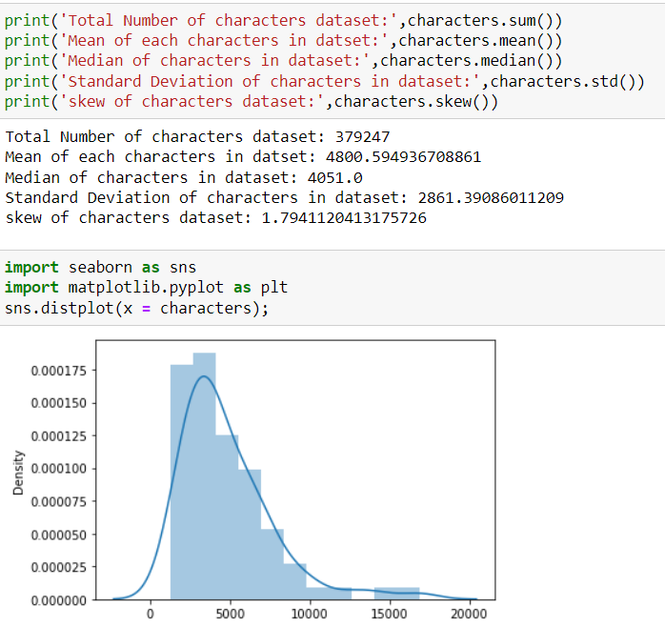
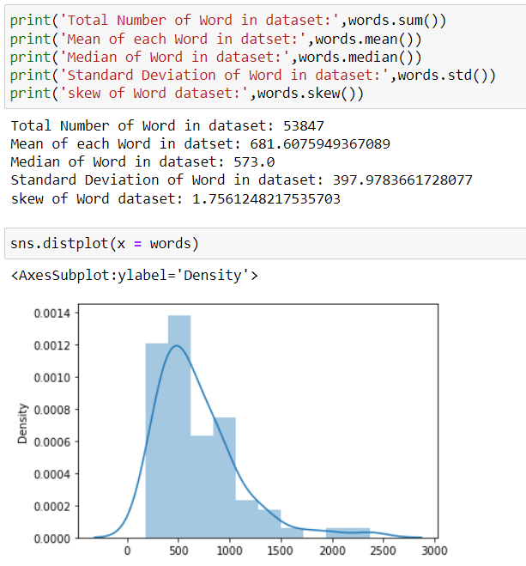
Density Plot for Characters and Words in Resumes :

Slide 13
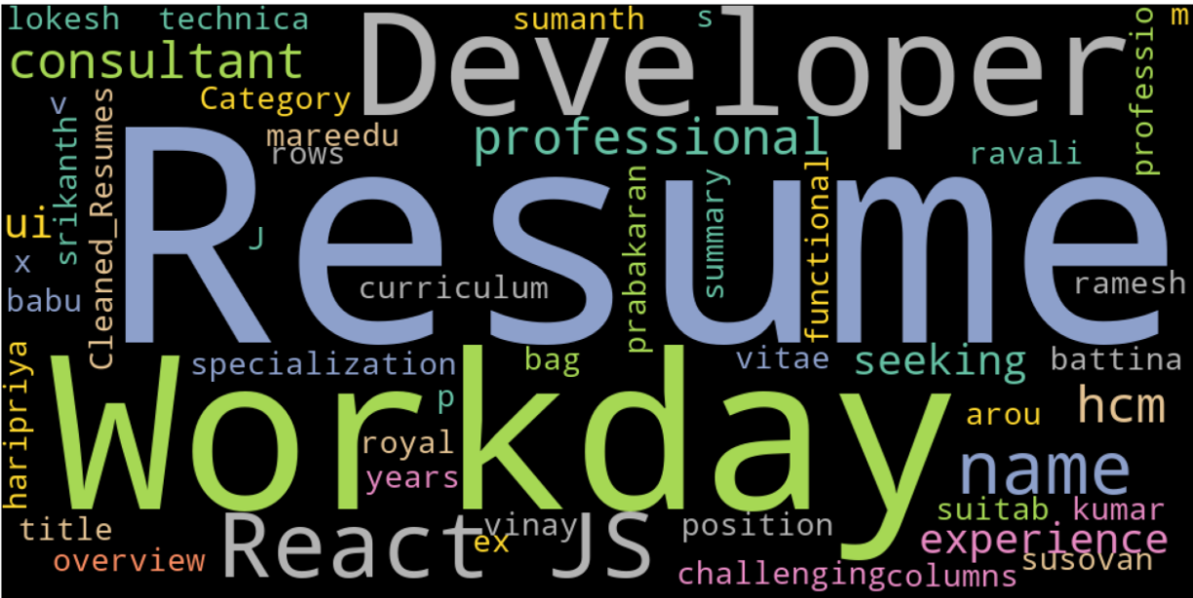
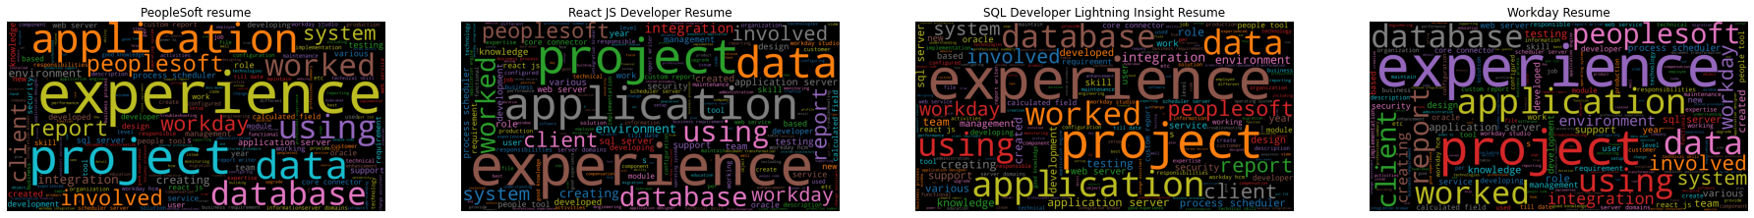
WORDCLOUD :

Slide 14
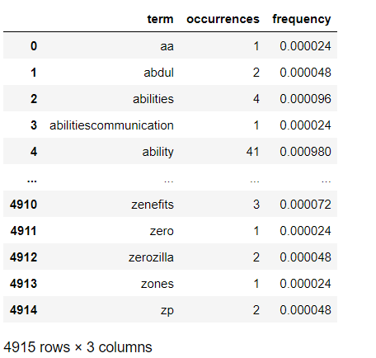
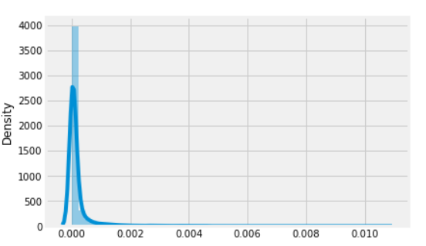
BAG OF WORDS(BOW) :
A bag-of-words is a representation of text that describes the occurrence of words within a document. It involves two things: A vocabulary of known words. A measure of the presence of known words
COUNT VECTORIZATION
Count Vectorizer is used to convert a collection of text documents to a vector of term/token counts. It also enables the ​pre-processing of text data prior to generating the vector representation.

Slide 15
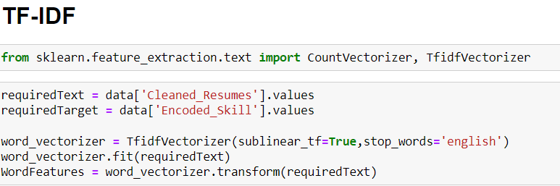
TFIDF - Term frequency inverse Document Frequency :
TF-IDF is better than Count Vectorizers because it not only focuses on the frequency of words present in the corpus but also provides the importance of the words.
We can then remove the words that are less important for analysis, hence making the model building less complex by reducing the input dimensions.

Slide 16
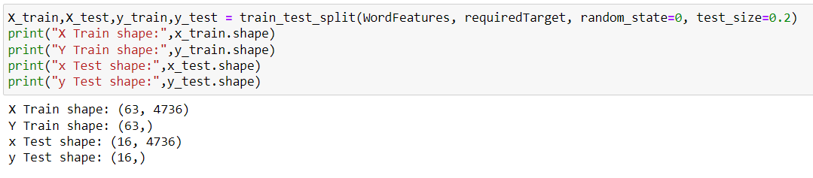
MODEL BUILDING
DATA PREPROCESSING
We have split data into two dataset: Train and Test. The ratio of splitting was 80 x 20.
The shape of train and test splitting:
SHAPE OF TRAIN DATA : 63
SHAPE OF TEST DATA : 16

Slide 17
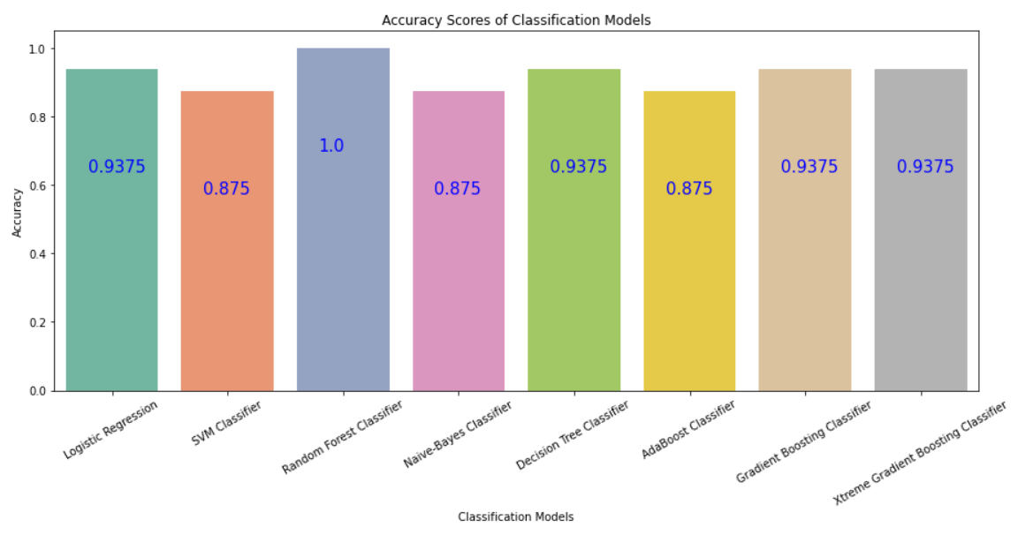
ACCURACY SCORE
We have trained and tested each model and recorded the resultant accuracy. Below graph shows the accuracy of each classifier.

Slide 18
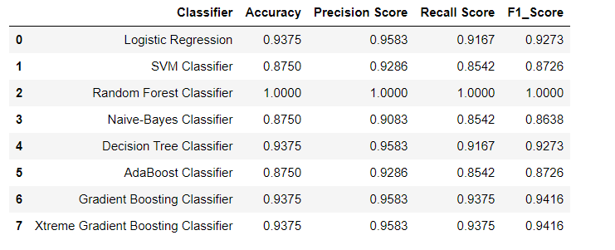
CLASSIFICATION REPORT
Accuracy tells us how many times the model was correct
Precision is how good the model is at predicting a specific category
Recall tells us how many times the model was able to detect a specific category
F1_score is combines the precision and recall of a classifier into a single metric by taking their harmonic mean

Slide 19
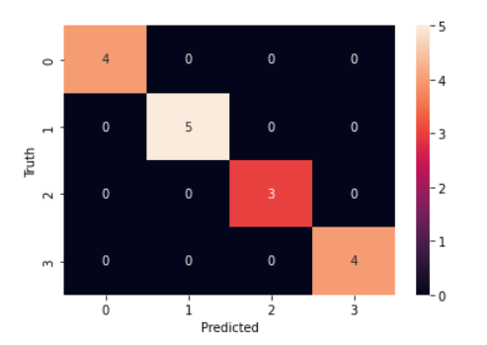
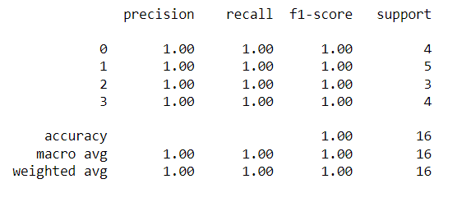
Finalizing model
from the accuracy , precision, recall,F1_score comparison, we got 100% result for random forest classifier.

Slide 20
DEPLOYMENT
After model building and Evaluation process, We have deployed the code using “ Streamlit ”.
We have selected the best model RANDOM FOREST CLASSIFIER and used in our deployment phase

